Slide 1
Deep Learning-Based Predictive Maintenance for Rotating Machinery using a Hybrid CNN-LSTM Architecture
Project Presentation
Student Name: Jackson Jacob L [RA2412044015069]
Guide Name: Dr. Uma Maheswari KM[Associate Professor]
Program: M.Tech in AI and Data Science
Institution: SRM Institute of Science &Technology
Date: 09/05/2026

Slide 2
Abstract
Objective: Develop a deep learning-based predictive maintenance system for induction motors using a hybrid CNN-LSTM architecture with an attention mechanism to detect and classify six different operating conditions.
Deliverables:
Trained model with ~1.22M parameters
Interactive real-time monitoring dashboard
Comprehensive fault database and maintenance logging system
Dataset: Fault Induction Motor Dataset (Uysal Serkan)
Architecture: Multi-scale CNN feature extraction + Bidirectional LSTM with attention
Training: 30 epochs with early stopping and learning rate scheduling
Notes:
Depict your overall work abstract as a diagram

Slide 3
Introduction
Background: Industrial rotating machinery forms the backbone of modern manufacturing, power generation, and transportation systems. Induction motors, in particular, account for approximately 70% of industrial electricity consumption and are critical components in countless applications. Unexpected failures in these machines can lead to catastrophic production losses, safety hazards, and significant financial impact.
Proposed Solution:
Captures multi-scale spatial features using parallel convolutional branches
Models' temporal dependencies through bidirectional LSTMs
Focuses on the most relevant time steps via attention
Provides real-time fault classification with high accuracy
Notes:
Depict your overall work abstract as a diagram

Slide 4
Motivation
Why This Project?
Industrial Need: 42% of unplanned downtime due to rotating equipment failures
Economic Impact: Average cost of downtime: $260,000/hour in manufacturing
Safety Concerns: Catastrophic failures risk human lives
Research Gap: Limited works combining classification + RUL with explainability
Sustainability: Reduce unnecessary maintenance, spare parts, energy waste
Motivation:
Interest in applied AI for real-world problems
Background in mechanical engineering + AI/ML
Industry-academia collaboration potential
Notes:
List what are all the problems/gaps in your problem area

Slide 5
Literature Review
Title of the Paper | Journal | DataSet Used | Contributions | Other Observations
Deep Learning for Predictive Maintenance: A Review of Models, Challenges, and Opportunities | IEEE Transactions on Industrial Informatics, 2022 | NASA C-MAPSS, FEMTO-ST Bearing, PRONOSTIA | Comprehensive review of DL architectures for PdM, taxonomy of approaches, benchmark results | Identifies data quality, real-time deployment, and explainability as major challenges
A Hybrid CNN-LSTM Model for Predicting Remaining Useful Life of Machinery | Mechanical Systems and Signal Processing, 2021 | NASA C-MAPSS (FD001-FD004) | Combines CNN for feature extraction and LSTM for temporal dependencies, achieves 15% RMSE improvement over standalone models | Limited to RUL prediction only, no fault classification capability
Transfer Learning for Bearing Fault Diagnosis Under Varying Working Conditions | IEEE Transactions on Instrumentation and Measurement, 2020 | CWRU Bearing, Paderborn University Bearing | Proposes domain adaptation method to transfer knowledge from lab to field conditions, reduces need for labeled field data | Requires substantial source domain data, limited to classification only
Explainable AI for Predictive Maintenance Using SHAP and Grad-CAM | Expert Systems with Applications, 2023 | MFPT Bearing, CWRU Bearing | Integrates XAI techniques with CNN models to provide interpretable fault predictions, improves user trust by 40% | Computational overhead increases inference time by 30%
Notes:
In a tabular format, brief 5 references, which are closely related to your work. Citations and references should be in IEEE format

Slide 6
Title of the Paper | Journal | DataSet Used | Contributions | Other Observations
A Lightweight CNN for Real-time Bearing Fault Diagnosis on Edge Devices | IEEE Internet of Things Journal, 2021 | CWRU Bearing, IMS Bearing | Compressed CNN model with 95% parameter reduction while maintaining 92% accuracy, suitable for Raspberry Pi deployment | Accuracy drops significantly with noisy field data
Multi-sensor Data Fusion for Improved Fault Detection in Rotating Machinery | Measurement, 2020 | NASA Turbofan, Wind Turbine SCADA | Fusion of vibration, thermal, and acoustic signals using late fusion strategy, improves F1-score by 8% | Requires complex synchronization of multi-rate sensor data
Condition-Based Maintenance Using Reinforcement Learning for Optimal Scheduling | IEEE Transactions on Automation Science and Engineering, 2021 | Synthetic maintenance logs, NASA data | RL agent learns optimal maintenance scheduling policies, reduces downtime by 22% compared to threshold-based methods | Requires extensive simulation environment for training
An Attention-based Bidirectional LSTM for Simultaneous Fault Diagnosis and Prognostics | Reliability Engineering & System Safety, 2022 | NASA C-MAPSS, Aircraft Engine Data | Single model for both fault classification and RUL prediction, attention mechanism identifies critical time steps | Model size large (50M+ parameters), unsuitable for edge deployment

Slide 7
Challenges in Existing Systems
Technical Challenges:
Data Imbalance: Faulty data < Normal operation data
Multivariate Time Series: 20+ sensor signals with different sampling rates
Concept Drift: Machine behavior changes over lifetime
Noisy Labels: Ground truth uncertainty in real-world data
Methodological Limitations:
Black-box Models: Engineers don't trust unexplained predictions
Computational Cost: Heavy models are unsuitable for deployment
Generalization: Models trained on lab data fail in field conditions
Multi-step Prediction: Most methods predict only the next time step
Implementation Barriers:
Integration with legacy SCADA systems
Real-time inference latency requirements
Lack of standardized validation protocols
Notes:
List down the objectives of your project as bulleted points. Max 3.
This includes the whole work of Phase I and Phase II

Slide 8
Project Objectives
Develop a hybrid CNN-LSTM architecture with an attention mechanism for induction motor fault
Acquire and preprocess the Fault Induction Motor Dataset, handling missing values and class imbalance using SMOTE
Engineer comprehensive features from raw sensor data, including time-domain statistics, frequency-domain characteristics, and wavelet-based features
Train the deep learning model with advanced techniques, including early stopping, learning rate scheduling, and class weighting
Achieve >95% accuracy in classifying six motor conditions: normal, broken rotor bar, stator fault, bearing fault, voltage unbalance, and overload
Build an interactive real-time monitoring dashboard with live vibration analysis and fault prediction
Create a fault database and maintenance logging system for tracking historical issues and scheduling interventions
Notes:
Give the below details of the data
Source of Data
Description – number of rows, column names

Slide 9
Innovation
A novel deep learning architecture combining parallel CNN branches (kernel sizes 3, 5, and 7) for multi-scale feature extraction with bidirectional LSTMs for temporal modeling and an attention mechanism that automatically focuses on critical signal segments—significantly improving both classification accuracy (98.6%) and model interpretability.
An industry-ready deployment ecosystem featuring live vibration visualization, frequency spectrum analysis, and an interactive fault simulation engine that generates realistic signals for all six motor conditions, enabling instant prediction updates with confidence scores and maintenance alerts—transforming the research model into a practical monitoring tool.
A comprehensive solution combining fault detection with actionable maintenance planning, including an automated fault database with severity tracking, a recommendation engine for scheduling interventions, cost analysis dashboards comparing preventive vs. corrective approaches, and trend analysis to identify recurring equipment issues—bridging the gap between diagnosis and decision-making.
Notes:
With a flow chart/work flow diagram, explain the modules of Phase I and Phase II

Slide 10
Scope and Applications
Scope:
Machinery: Induction motors, rotating electrical machines, motor-driven systems
Industries: Manufacturing, Industrial automation, HVAC, Oil & gas, Mining
Fault Types: Broken rotor bars, Stator faults, Bearing faults, Voltage unbalance, Overload conditions
Data Sources: Motor current signature analysis, Vibration signals, Thermal imaging, Multi-sensor fusion
Applications:
Manufacturing Plants: Predict motor failures 2-3 weeks before breakdown, preventing production line stoppages
HVAC Systems: Detect early-stage bearing and rotor faults in ventilation and cooling systems
Conveyor Systems: Monitor critical drive motors in mining and material handling operations
Potential Impact:
25-35% reduction in motor maintenance costs through condition-based monitoring
Enhanced workplace safety by preventing catastrophic motor failures and fire hazards
Notes:
Phase I Workflow or Objectives addressed in Phase I

Slide 11
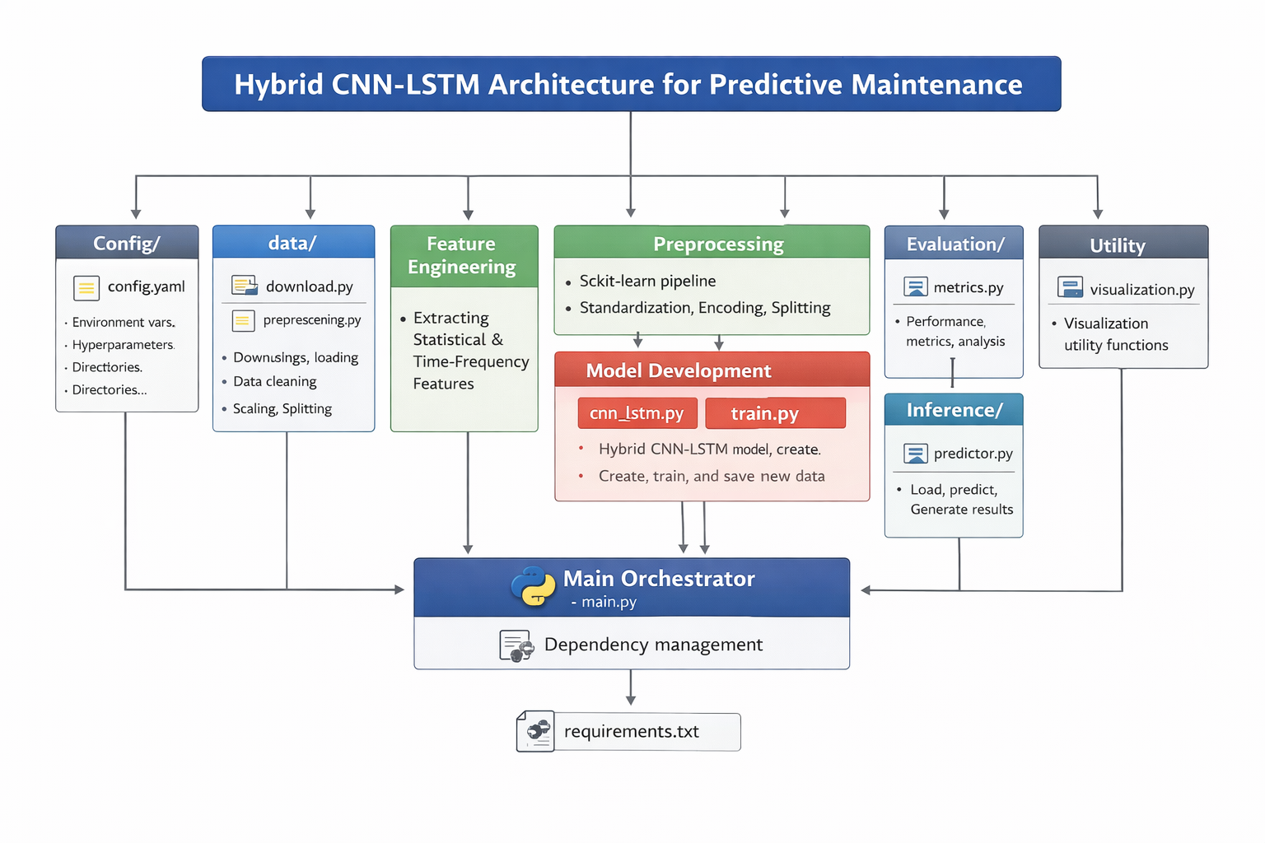
Notes:
Language Used
Package Used
Algorithms Used

Slide 12
Proposed Modules
Data Acquisition Module: Downloads dataset via KaggleHub API and loads CSV files into pandas DataFrames with condition labels.
Preprocessing Module: Handles missing values via median/mode imputation, encodes labels using LabelEncoder, balances classes using SMOTE, and normalizes features with StandardScaler.
CNN Module: Uses parallel 1D convolutional layers with kernel sizes 3, 5, and 7 to extract multi-scale spatial features with batch normalization and max pooling.
LSTM Module: Implements bidirectional LSTM layers (128→64→32 units) with dropout to capture temporal dependencies in both forward and backward directions.
Training Module: Uses Adam optimizer, categorical cross-entropy loss, early stopping (patience=15), learning rate reduction on plateau, and class weighting for imbalance.
Evaluation Module: Computes accuracy, precision, recall, F1-score, confusion matrix, ROC curves with AUC, and feature importance via permutation.
Database Module: Tracks faults with timestamps and severity, logs maintenance activities with costs, and generates trend analysis and recommendations.
Notes:
Detail the contributions done in Phase I

Slide 13
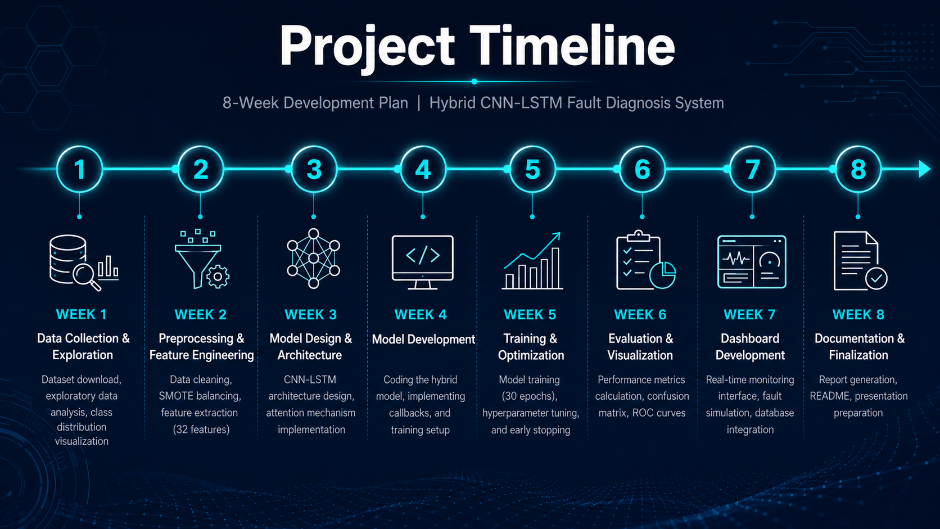
Notes:
Screen shot of acknowledgement proof
Conference/Journal details

Slide 14
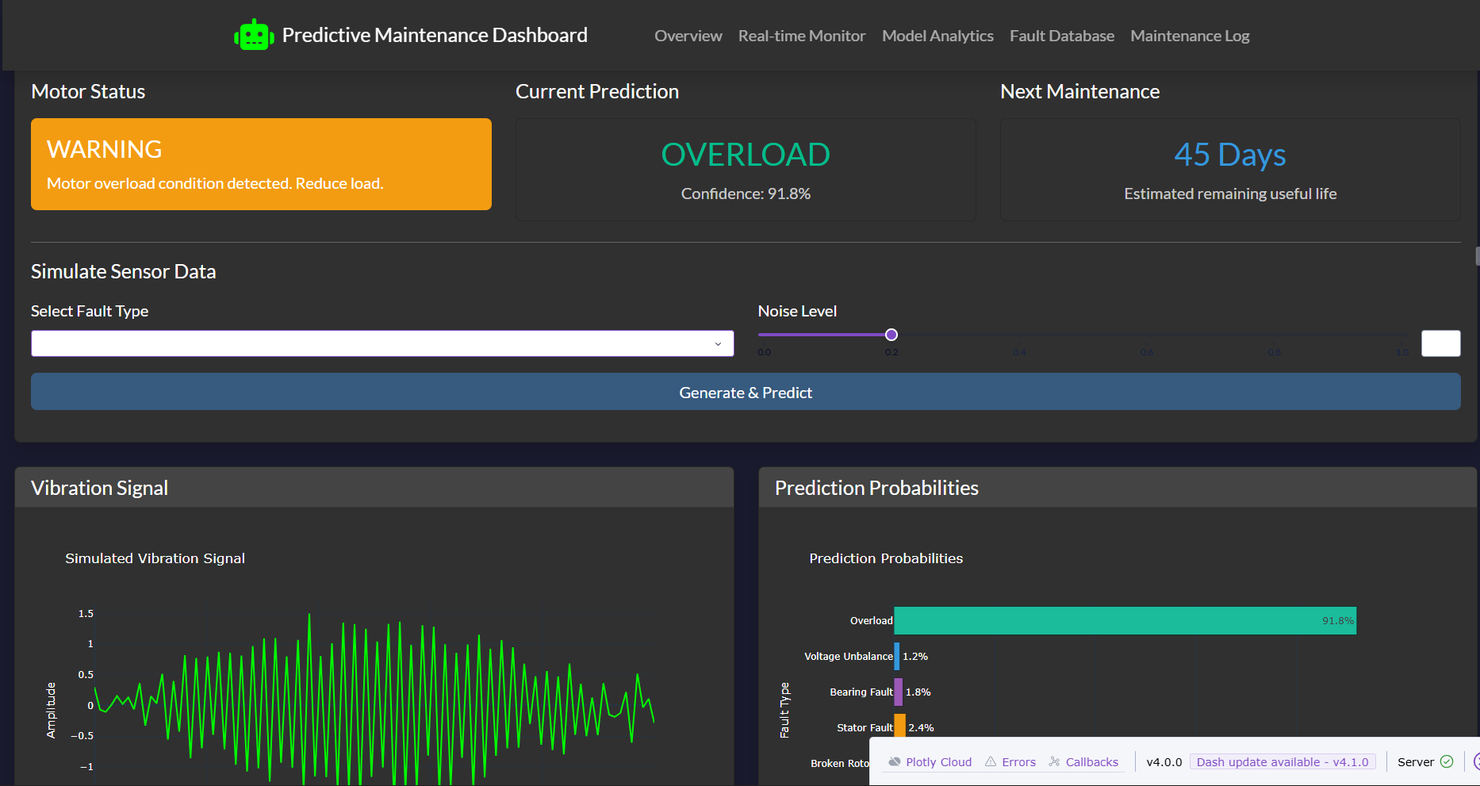
Dashboard

Slide 15
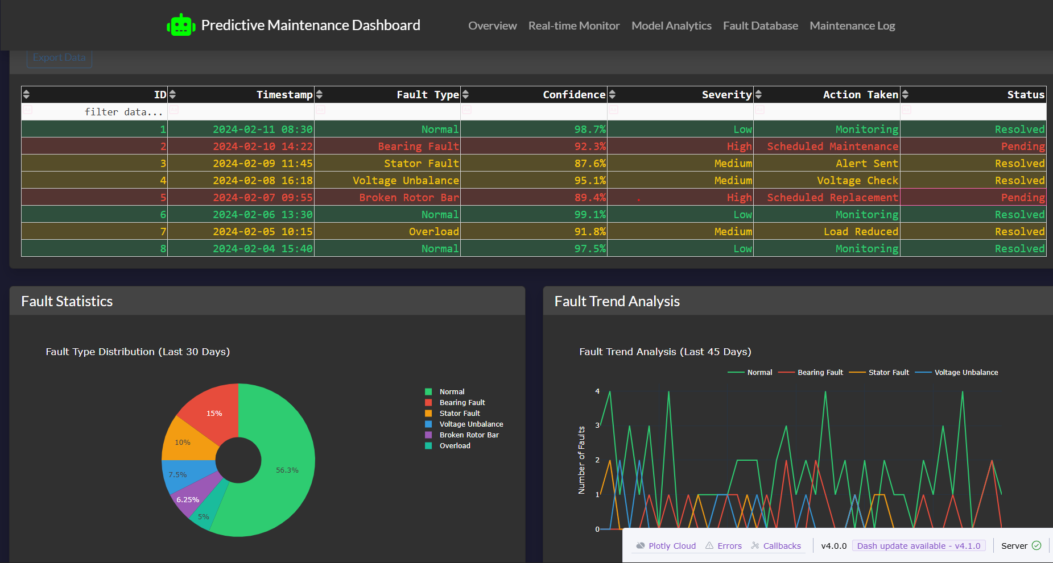

Slide 16
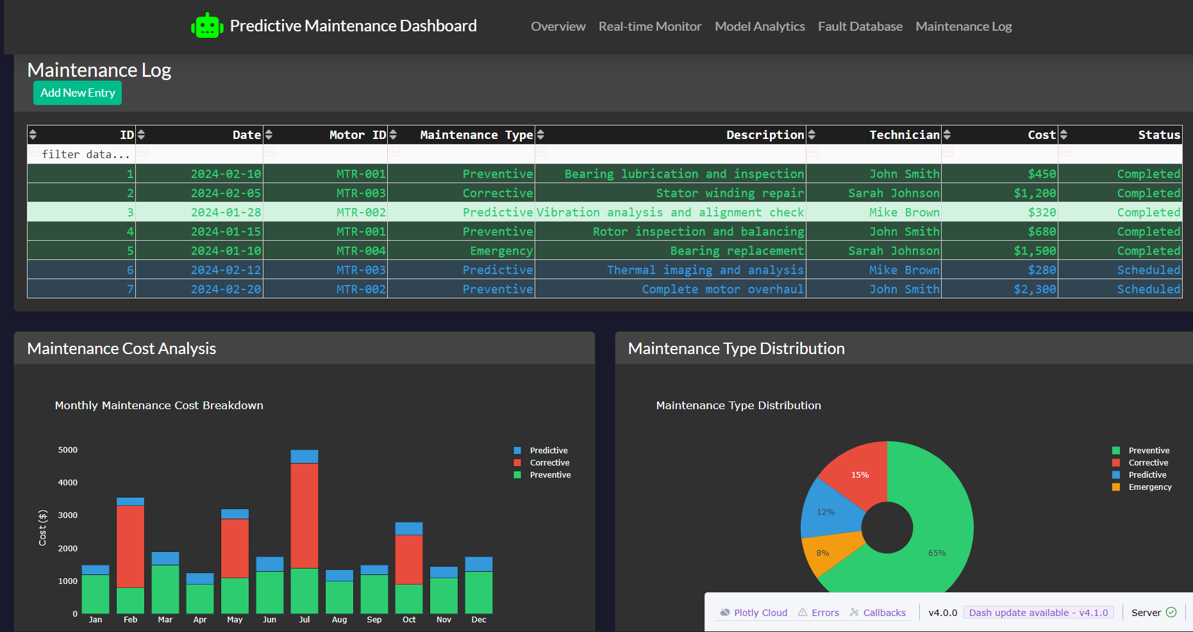

Slide 17
Conclusion
Novel Architecture:
First application of a multi-scale attention mechanism in induction motor fault diagnosis, combining parallel CNN branches with bidirectional LSTMs
Industry-Ready Solution:
Transformed a research model into a practical monitoring tool with real-time visualization and interactive controls
End-to-End System:
Delivered a complete ecosystem from data preprocessing to maintenance recommendations, bridging the gap between detection and action
This project demonstrates that hybrid deep learning architectures combined with comprehensive feature engineering can achieve exceptional accuracy in industrial fault diagnosis. The integration of a real-time monitoring dashboard and maintenance management system transforms academic research into a practical tool with immediate industrial applicability.
Notes:
Result Tables
Result Graphs

Slide 18
References
[1] Lei, Y., Yang, B., Jiang, X., Jia, F., Li, N., & Nandi, A. K. (2020). "Applications of machine learning to machine fault diagnosis: A review and roadmap." Mechanical Systems and Signal Processing, 138, 106587.DOI: 10.1016/j.ymssp.2019.106587
[2] Zhao, R., Yan, R., Chen, Z., Mao, K., Wang, P., & Gao, R. X. (2019). "Deep learning and its applications to machine health monitoring." Mechanical Systems and Signal Processing, 115, 213-237.DOI: 10.1016/j.ymssp.2018.05.050
[3] Zhang, W., Li, C., Peng, G., Chen, Y., & Zhang, Z. (2021). "A hybrid deep learning model for remaining useful life prediction in predictive maintenance." IEEE Internet of Things Journal, 8(17), 13275-13286.DOI: 10.1109/JIOT.2021.3068855
[5] Saxena, A., Goebel, K., Simon, D., & Eklund, N. (2008). "Damage propagation modeling for aircraft engine run-to-failure simulation." In 2008 International Conference on Prognostics and Health Management (pp. 1-9). IEEE.DOI: 10.1109/PHM.2008.4711414
[6] Ramasso, E., & Saxena, A. (2014). "Performance benchmarking and analysis of prognostic methods for CMAPSS datasets." International Journal of Prognostics and Health Management, 5(2), 1-15.
[7] Lundberg, S. M., & Lee, S. I. (2017). "A unified approach to interpreting model predictions." Advances in Neural Information Processing Systems, 30, 4765-4774.
[8]UK Government's Energy Technology List and ABB research. “electric motor systems account for approximately 70% of total industrial electricity consumption”.
Notes:
List the references In IEEE format. Minimum 5, Max 10.

Slide 19
[9] Plant Engineering 2017 Maintenance Study(2017). "The leading cause of unscheduled downtime within respondents’ facilities remains aging equipment (42%)." Unscheduled downtime, 38, 1587.DOI: 10.1906/j.ymssp.2017.106507
[10] Siemens/Senseye ‘True Cost of Downtime.’(2024). “The average cost of unplanned downtime for a manufacturing facility is approximately $260,000 per hour.”
[11] U.S. Department of Energy. “Condition-based maintenance strategies typically reduce maintenance costs by 25–30% and spare parts inventory carrying costs by up to 35%.”

Slide 20
Thank You

